Slide 1
U.S. Copyright Law
INFO 4940/5940
Instructor: Mike Priehs
Subjects of Copyright
February 3, 2025

Slide 2
Refresher
The Foundations of Copyright
  U.S. Constitution
  Balance of Interests
    Exclusive Rights v. Limitations
  Original, Creative, Fixed
  Copyright(s) – Bundle of Rights
  Idea v. Expression

Slide 3

This Week’s Outline
The Subjects of Copyright
Literary Works (and Software)
Dramatic Works (and Choreography)
Music
Audiovisual Works
Fictional Characters
Visual and Architectural Works

Slide 4
Growth of U.S. Copyright
Books, Maps, & Charts (1790)
Prints (1802)
Music (1831)
Dramatic Works (1856)
Photographs (1865)
Paintings & Drawings (1870)
Sculpture (1870)
Advertisements (~1900)
Movies (1903)
Lectures (1909)
Fictional Characters & Plots (~1909)
Useful Objects (1909-1954)
Sound Recordings (1972)
Choreography (1976)
Software (1978)
Architecture (1990)

Slide 5
17 US Code §102- Subject Matter of Copyright
(a)Copyright protection subsists, in accordance with this title, in original works of authorship fixed in any tangible medium of expression, now known or later developed, from which they can be perceived, reproduced, or otherwise communicated, either directly or with the aid of a machine or device. Works of authorship include the following categories:
  (1)literary works;
  (2)musical works, including any accompanying words;
  (3)dramatic works, including any accompanying music;
  (4)pantomimes and choreographic works;
  (5)pictorial, graphic, and sculptural works;
  (6)motion pictures and other audiovisual works;
  (7)sound recordings; and
  (8)architectural works.

Slide 6
Subjects of Copyright
Literary Works

Slide 7
Literary Works
The “heart” of copyright protection
Includes:
  Novels
  Short Stories
  Poems
  Newspaper & Magazine Articles
  Software

Slide 8
Literary Works (and Software)
What do software IP owners want to prevent?
  Consumer reproduction of object code
  Commercial reproduction of object code
  Incorporation of parts of source code in new programs (“follow-on copying”)
  Nonliteral copying

Slide 9
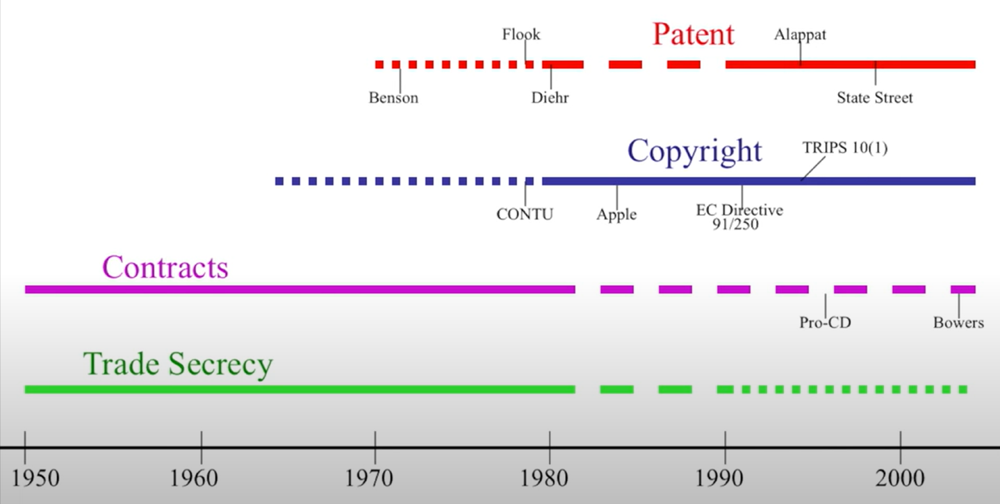
Forms of IP for Software

Slide 10
Subjects of Copyright
Dramatic Works (and Choreography)

Slide 11
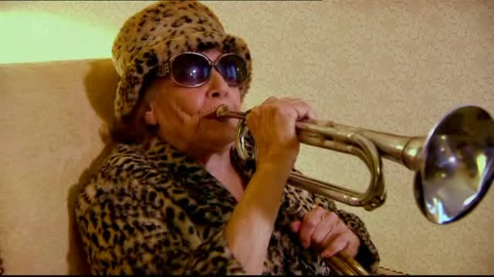
Screen Capture from Perspectives: Paul O’Grady: Gypsy Rose Lee – The Queen of Burlesque (2013)
Notes:
Faith Dane
1923-2020
Actor, musician, artist, and 9-time candidate for mayor of Washington, DC
Faith performed in both the original Broadway and film versions of the musical Gypsy.
When Gypsy was later back on Broadway, without Faith, she filed a suit claiming she’d created much of the character herself and should own copyrights.
NY Supreme Court
Mainly focused on a mock strip tease developed and performed for Gypsy
Court did not extend copyright protections to this choreography, stating:
"the words dramatic or dramatico-musical composition as used in the statute must be held to include only those representations and exhibitions which tend at least to promote the progress of science and the useful arts. Where a performance contains nothing of literary dramatic or musical character which is calculated to elevate, cultivate, inform, or improve the moral or intellectual natures of the audience, it does not tend to promote the progress of science or the useful arts. Thus, not everything put on stage can be subject to copyright. While the plaintiff's performance was no doubt amusing and entertaining to many, it does not fall within the purview of the statute as a production tending to promote the progress of science and the useful arts."
This lawsuit took place in 1963. Choreography wasn’t included as a subject of copyright until 1976.

Slide 12
“The words dramatic or dramatico-musical composition as used in the statute must be held to include only those representations and exhibitions which tend at least to promote the progress of science and the useful arts. Where a performance contains nothing of literary dramatic or musical character which is calculated to elevate, cultivate, inform, or improve the moral or intellectual natures of the audience, it does not tend to promote the progress of science or the useful arts. Thus, not everything put on stage can be subject to copyright. While the plaintiff's performance was no doubt amusing and entertaining to many, it does not fall within the purview of the statute as a production tending to promote the progress of science and the useful arts.”
– Court in the Dane/Gypsy suit

Slide 13
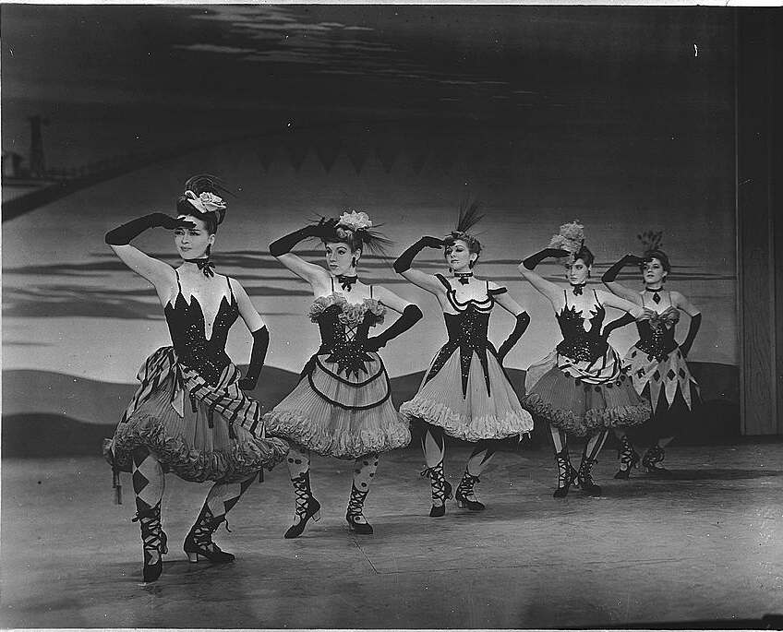
https://en.wikipedia.org/wiki/Dream_ballet#/media/File:Oklahoma_8e07920v.jpg

Slide 14
What Constitutes Choreography?
No definition in the statute
U.S. Copyright Office developed its own definition:
  "Choreography is the composition and arrangement of dance movements and patterns, usually intended to be accompanied by music. As distinct from choreography, pantomime is the act of imitating or acting out situations, characters, or other events. To be protected by copyright, pantomimes and choreography need not tell a story or be presented before an audience."

Slide 15
Fixation
Section 102:
  “Fixed in a tangible medium of expression“
Section 101:
  "A work is fixed in a tangible medium when its embodiment in a copy or phono record by or under the authority of the author is sufficiently permanent or stable to permit it to be perceived, reproduced, or otherwise communicated for a period of more than transitory duration. A work consisting of sounds, images, or both that are being transmitted is fixed for the purposes of this title if a fixation of the work is being made simultaneously with this transmission."

Slide 16
Subjects of Copyright
Music

Slide 17
Two Copyrights That Involve Music
Musical Compositions
Sound Recordings
  In most countries, these are neighboring rights
  In U.S., these are copyrights

Slide 18
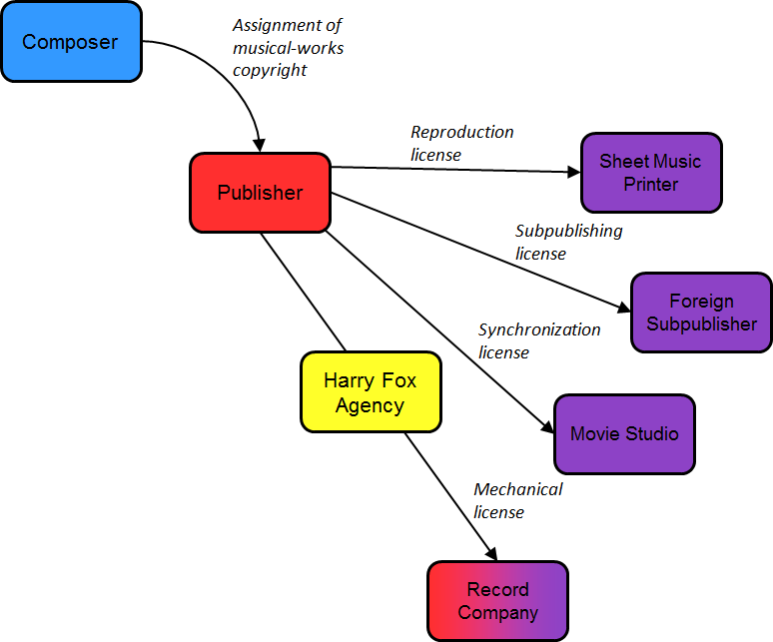

Slide 19
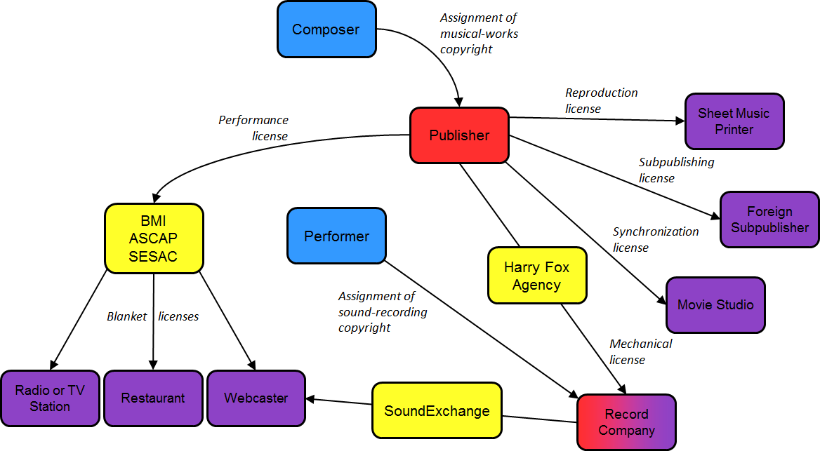

Slide 20
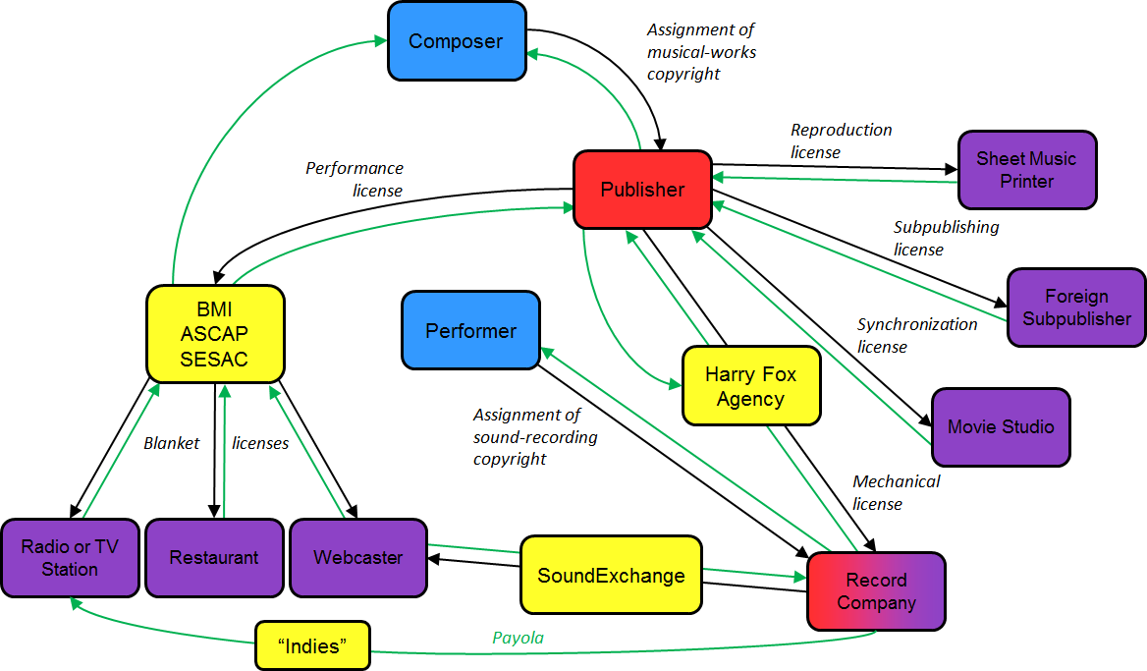

Slide 21
What about Cover Songs?
When a song is already published, a second musician/record label does not need to seek permission to record a cover version
Must pay a fee set by the government
  ~$0.091 per downloaded song or song on a physical album sale
Considered a “compulsory license”

Slide 22
Subjects of Copyright
Audiovisual Works

Slide 23
Audiovisual Works
Motion Pictures
  works that contain a series of related images that are intended to be shown with a projector, digital display, or other device. When the images are shown in successive order, they create an impression of movement that is perceptible to the eye
A/V Works
  Filmstrips
  Sets of Slides

Slide 24
Motion Pictures
Typically, only one copyright (in the film itself)
Most often, copyright is owned by producer of film
Do actors, screenwriters, directors, etc. share copyrights in the film?
  In some countries, yes. In the U.S., no.

Slide 25
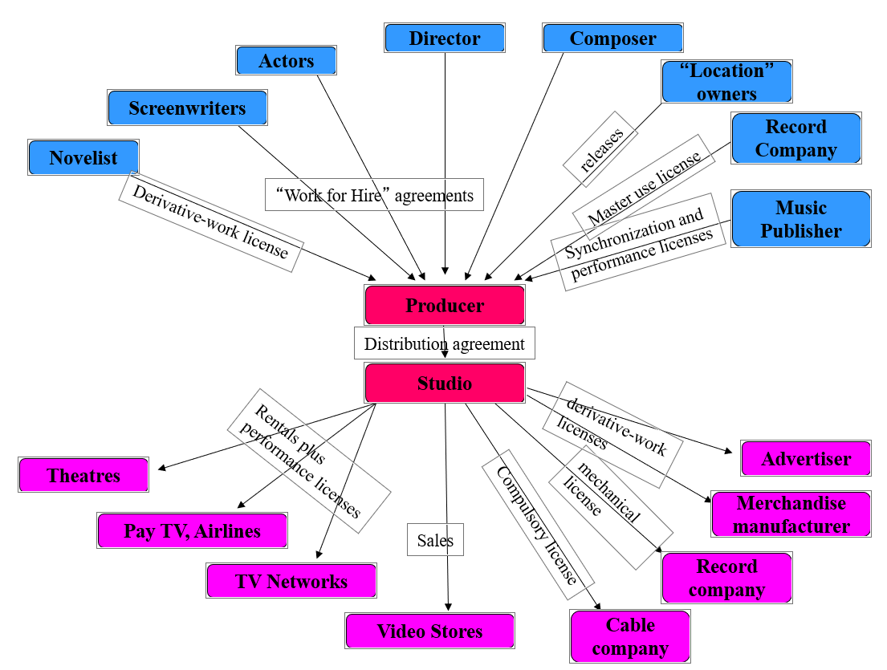

Slide 26
Subjects of Copyright
Fictional Characters

Slide 27
Fictional Characters
Relatively recent addition to copyright protection
A character described in a larger fictional work, such as a novel or a movie, now enjoys copyright protection independent of the work in which he or she appears
  Not every fictional character gets this protection. Only important characters

Slide 28
Which Fictional Characters are Protected?
U.S. Courts have two different tests to make determination
  Story Being Told / Sam Spade Test
  Well Delineated Test

Slide 29
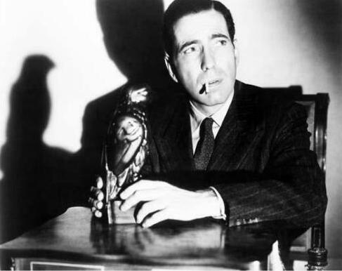
Story Being Told / Sam Spade Test

Slide 30
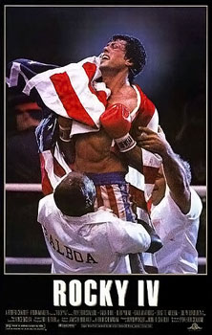
Well Delineated Test
https://en.wikipedia.org/wiki/Rocky_IV#/media/File:Rocky_IV.jpg

Slide 31
Subjects of Copyright
Visual and Architectural Works

Slide 32
Visual Art
Consists of PGS works (pictorial, graphical, and sculptural works)
Applied Art or Industrial Art
  Three dimensional objects that are both useful and attractive
    Unusual lamp, water bottle, shape of a laptop/tablet, eyeglasses, doorknob or window fixture, decorative table & chairs, etc.

Slide 33
Useful Objects / Articles
Art vs. Mechanical / Utilitarian Aspects
General Principle: Copyright applies if aesthetic and functional features of the item are separable

Slide 34
Conceptual Separability
Is the form of the object dictated by its function?
Is the aspect of the object in question primary?
Does the object stimulate the mind of the beholder a concept that is separate from its utilitarian function? (Temporal Displacement Test)
Can it stand on its own as a work of art?
What was the intent of the creator of the article?

Slide 35
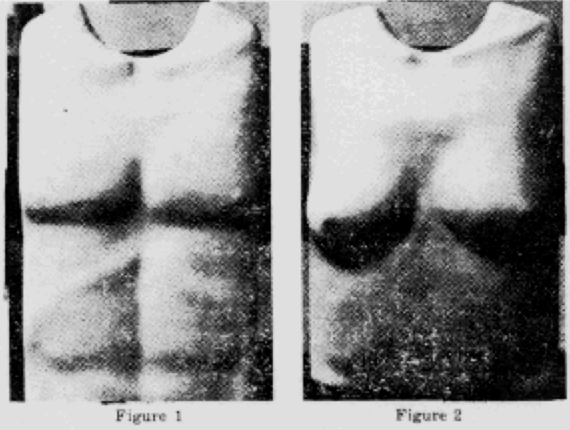
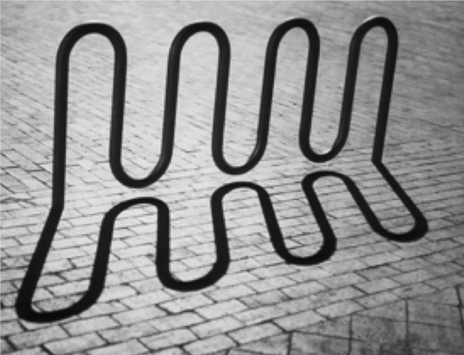
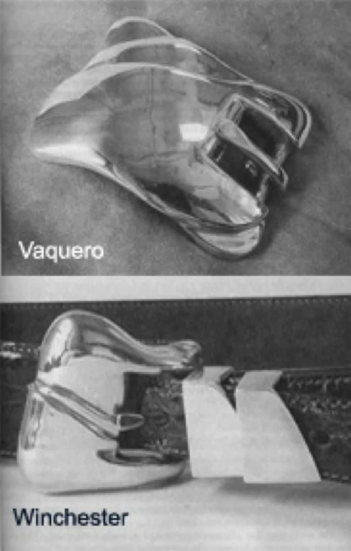
Is the aspect of the object in question primary?
Is the form of the object dictated by its function?
What was the intent of the creator of the article?

Slide 36
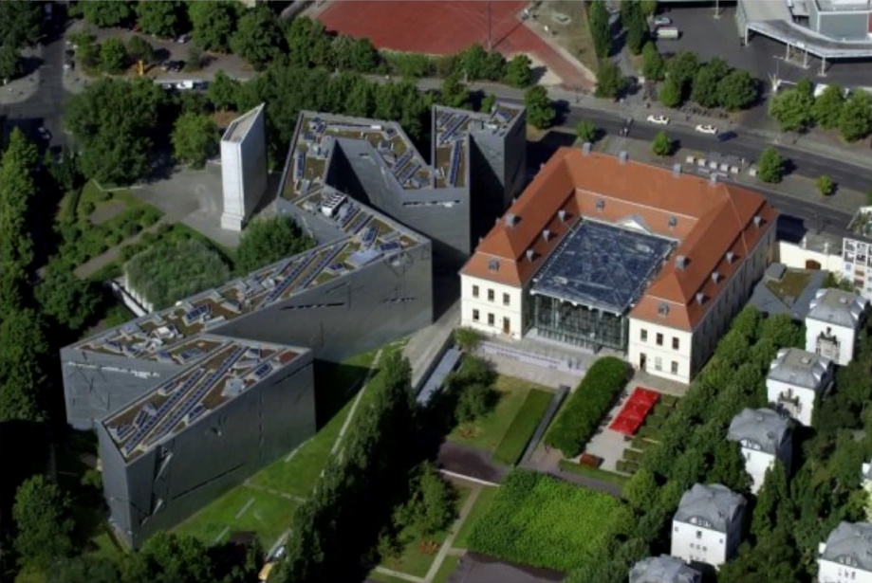
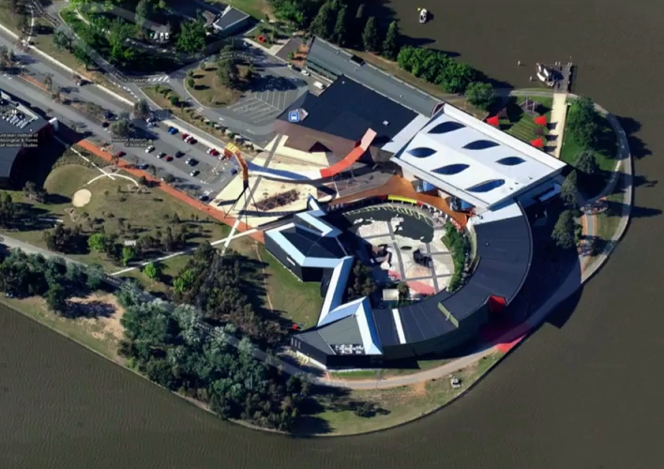
The Jewish Museum in Berlin
Designed by Daniel Libeskind
The National Museum of Australia
Designed by Howard Raggatt

Slide 37


